Slide 1
SECURE FUNDING TRAIL USING IN BLOCKCHAIN
B DHEERAJ REDDY (1PE17CS031)
DEEPAK M (1PE16CS406)
SHEIK MOHAMMED SUHAIL (1PE17CS423)
UNDER THE GUIDANCE OF PROF. EVLIN VIDYU LATHA
Crowdfunding using Smart contracts

Slide 2
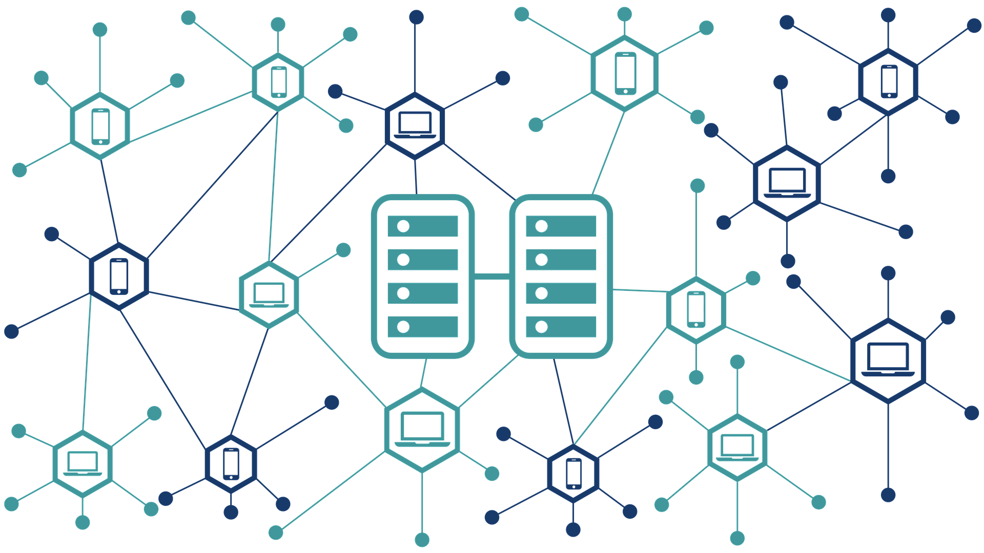
Problem Statement / Definition
Figure: Blockchain

Slide 3
Overview
Problem Statement Motivation of work
Methodology Implementation Results
Conclusion and future scope References

Slide 4


Problem Statement / Definition
1 Definition
Crowdfunding is the practice of funding a project or venture by raising small amounts of money from a large number of people, typically via the Internet or middleman. Smart contracts are used to eliminate middleman using blockchain.
Unlike traditional contracts or agreement written there is no need for a third person to read and implement the contract. The computer itself will read and execute the contract when all the predefined conditions are met.
Limitations of traditional crowdfunding
Every crowdfunding exchange today is dependent on one of several dedicated crowdfunding platforms which takes hectic fees.
Rules and regulations of platforms are very strict. Promises may not be fulfilled.
Copyright vulnerability is there.
2

Slide 5
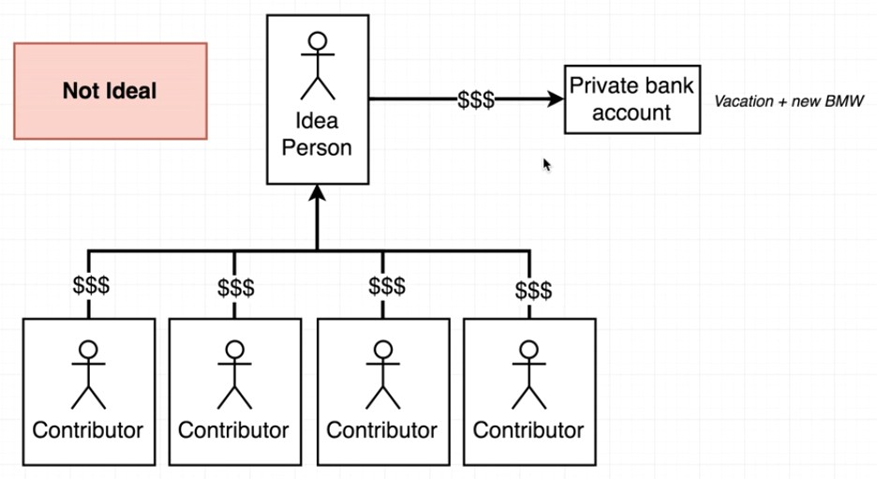
Problem Statement
Not ideal world

Slide 6
Motivation of the work
Crowdfunding allows businesses with really great products and service ideas to raise funds from regular people in small investment amounts. When it works, it can really give your business a big boost.
One of the problems is that even with crowdfunding, this model is still extremely inefficient, with 78 percent of campaigns not reaching their target goals and only 1.9 percent of funds that are raised through crowdsourcing campaigns going to developing countries.

Slide 7
Motivation of the work
Blockchain can change the crowdfunding game.
Because blockchain makes the funding process safe, accessible from anywhere in the world, and completely transparent, crowdfunding platforms that use blockchain can help to maximize the success of a project.
Decentralization of blockchain eliminates platform dependency. Accessible equity of ownership among investors.
Universal availability results in crowdfunding all over the world.
By immediate provision crowd funders don’t have to worry about “empty promises”.
Flexible options allows the crowd funders to buy partial shares. Peer to Peer allows to exchange product stakes.

Slide 8
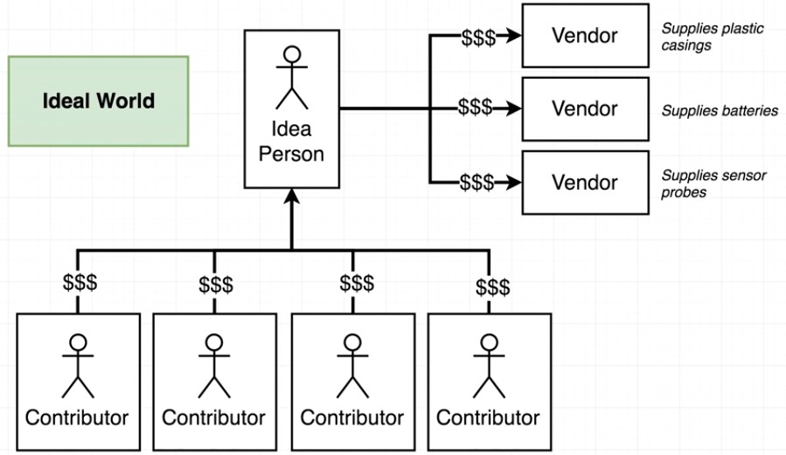
Methodology
Ideal world

Slide 9
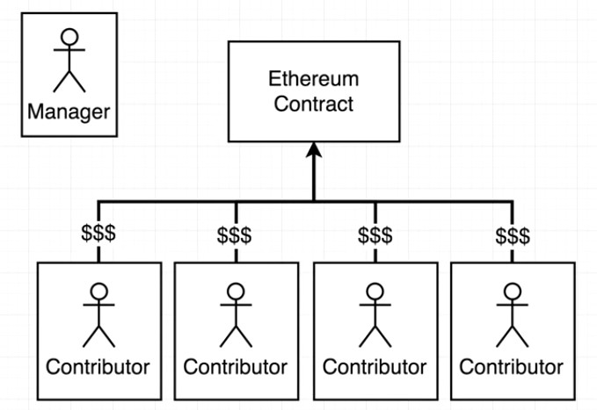
Methodology
How smart contracts will resolve the problem

Slide 10
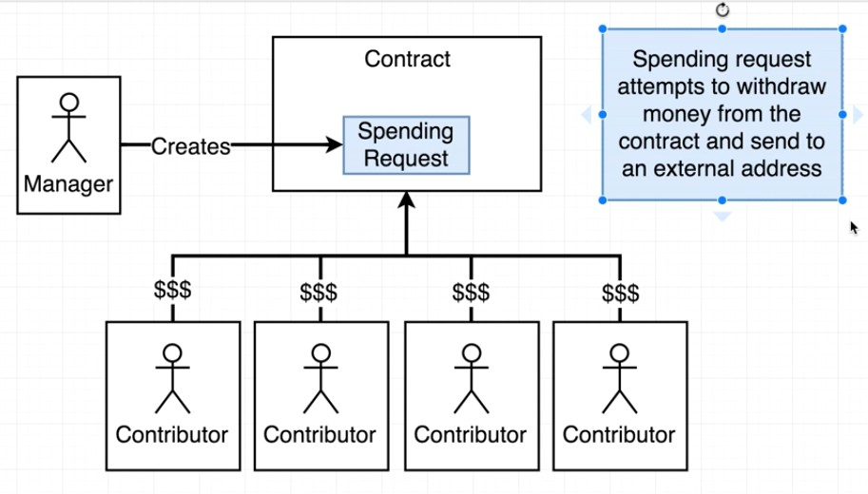
Methodology
How smart contracts will resolve the problem

Slide 11
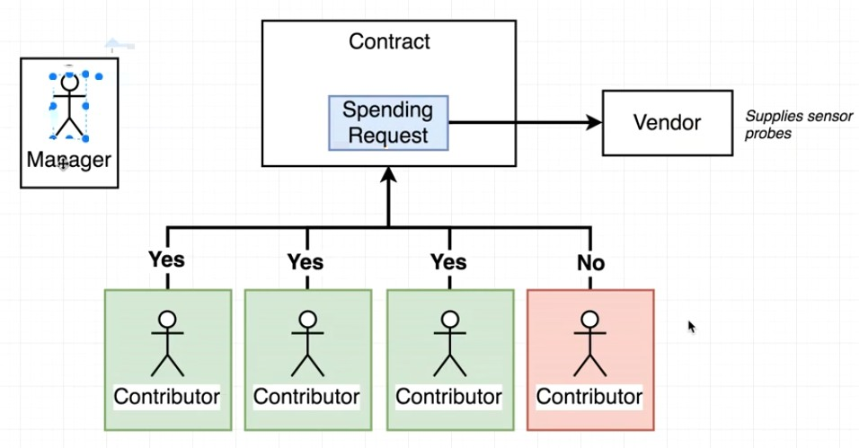
Methodology
Voting system

Slide 12
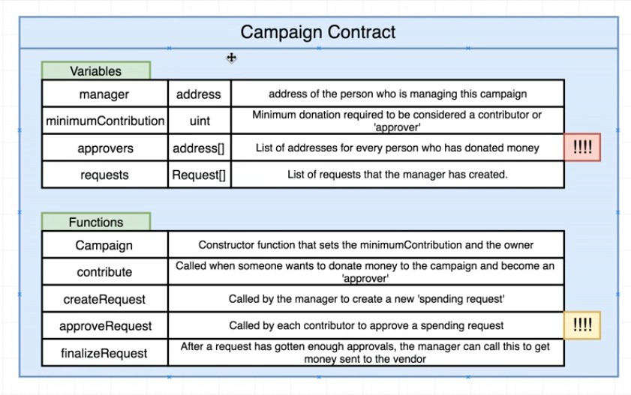
Methodology
Variables and functions

Slide 13
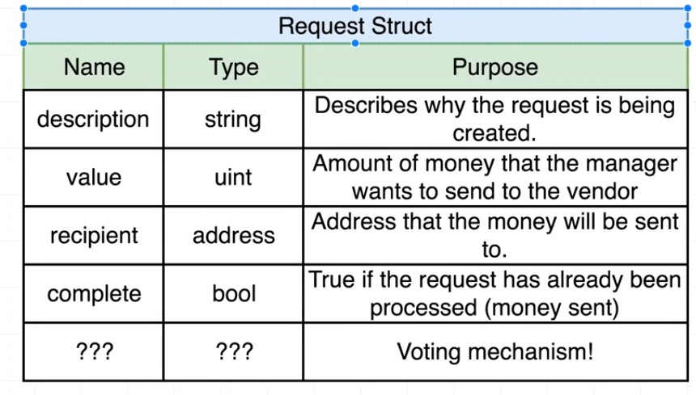
Methodology
Request structure

Slide 14
Methodology
First a project is created in constructor function.For that minimum contribution is required.
After a project is created interested investors can give contribute to the project by giving minimum contribution.
After that manager has to create request to spend money.
After creating request , contributors will vote whether manager can spend that money or not.
If more then half of contributors agree for spending,then that money can be spent.
After successful completion of project contributor will receive money with some profit.

Slide 15
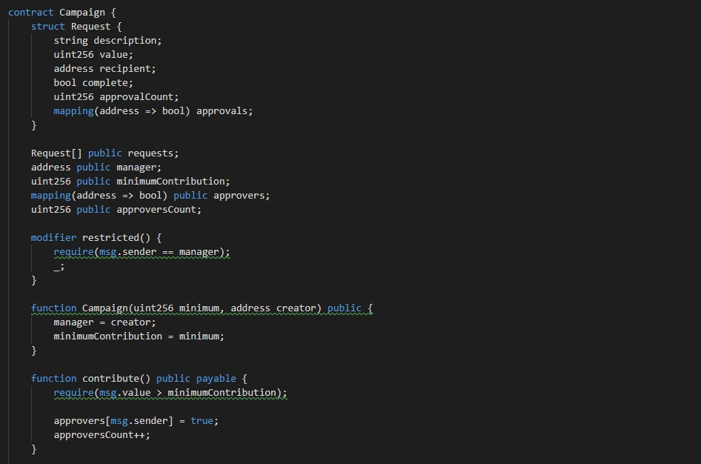
Implementation
Smart contract

Slide 16
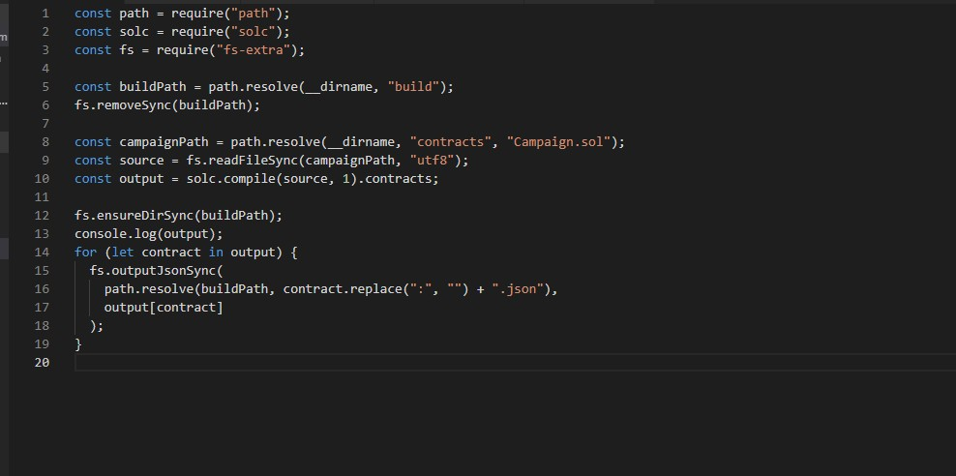
Implementation
Compile file

Slide 17
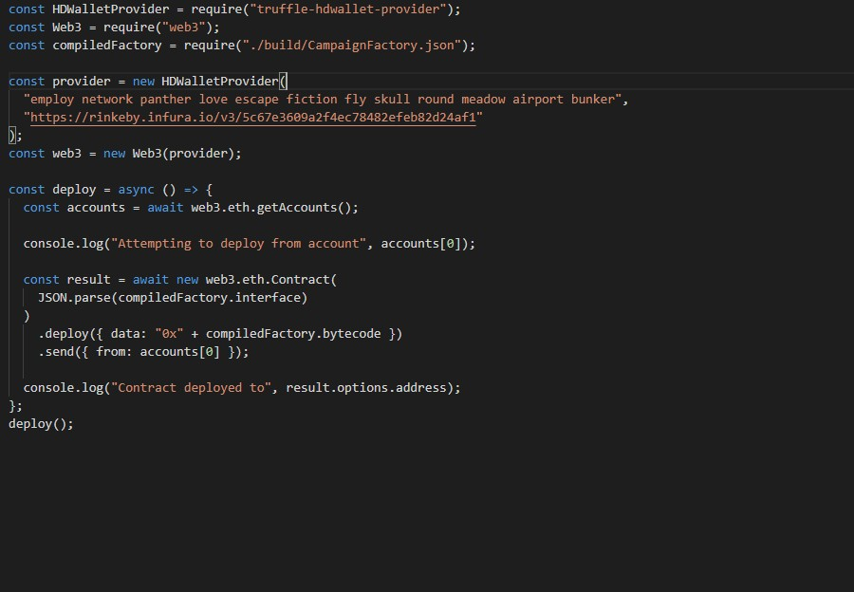
Implementation
Deploy file

Slide 18
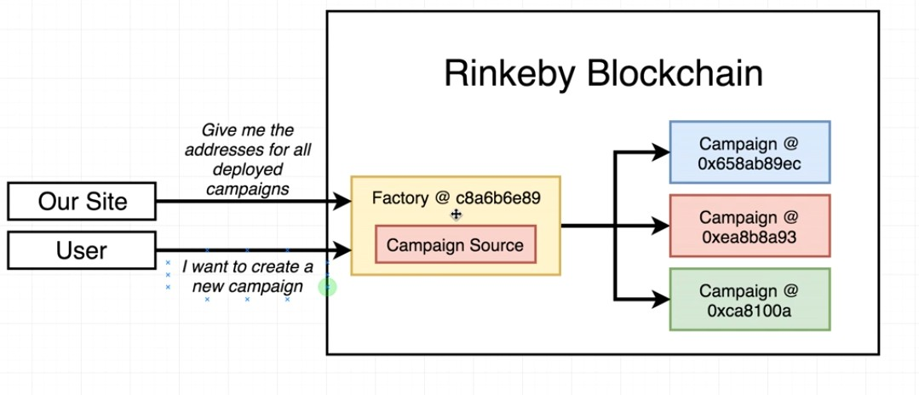
Implementation
Deployment

Slide 19
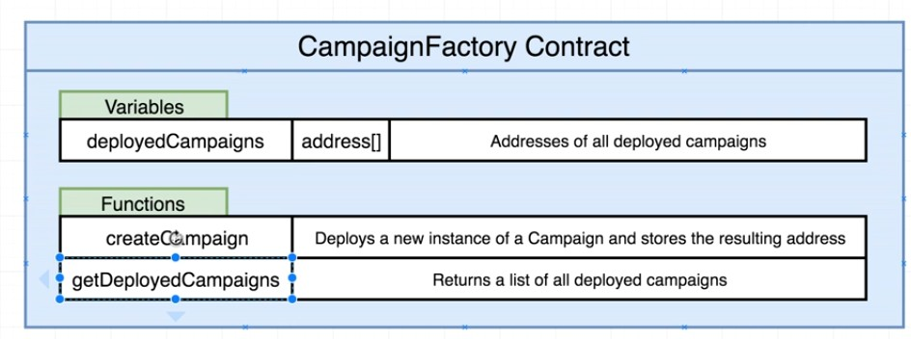
Implementation
Campaign factory

Slide 20
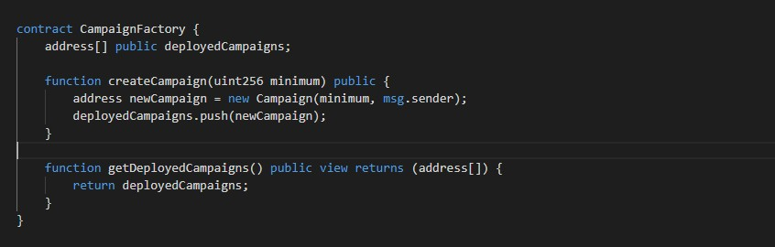
Implementation
Campaign factory contract

Slide 21
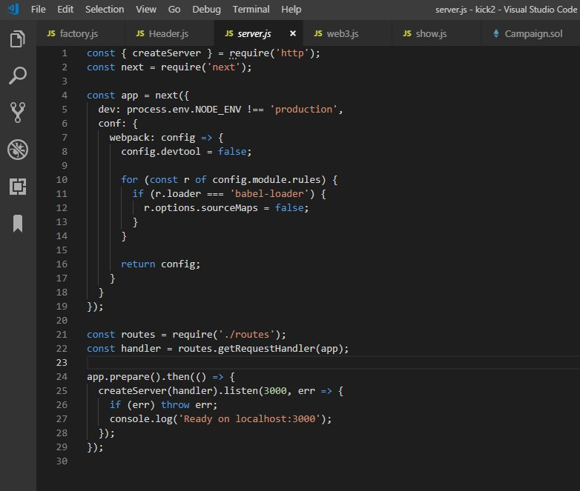
Implementation
Backend file for running server

Slide 22
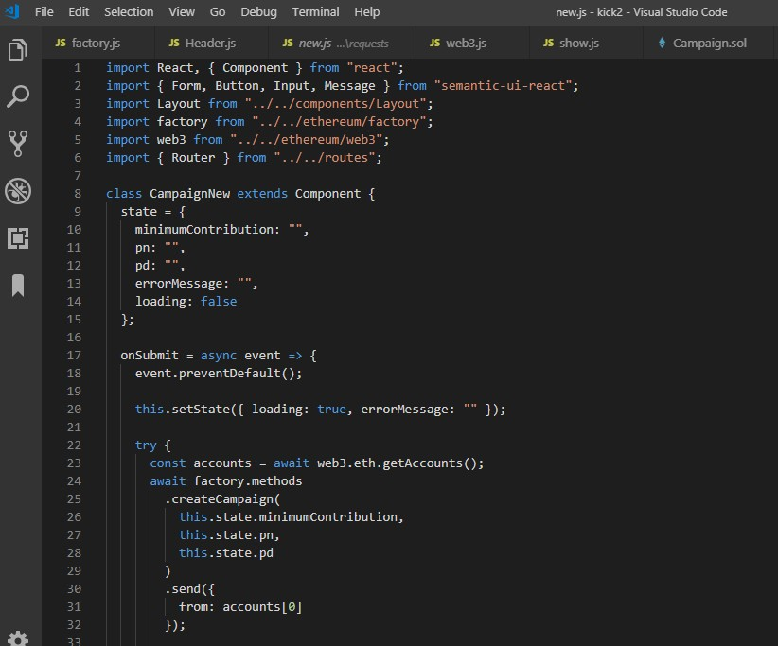
Implementation
Front end code to create a new project

Slide 23
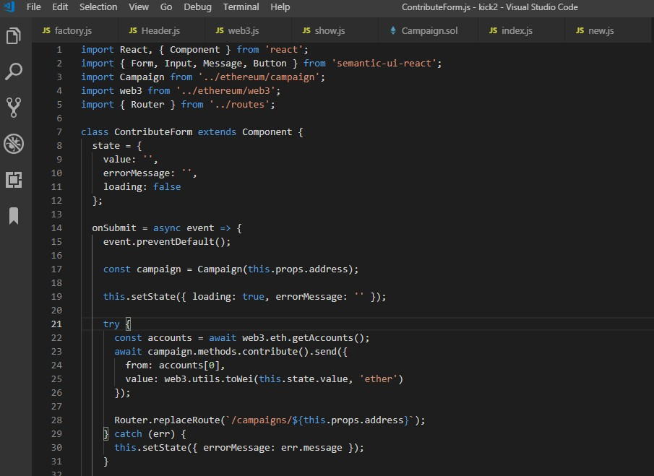
Implementation
Front end code to create a contribute form

Slide 24
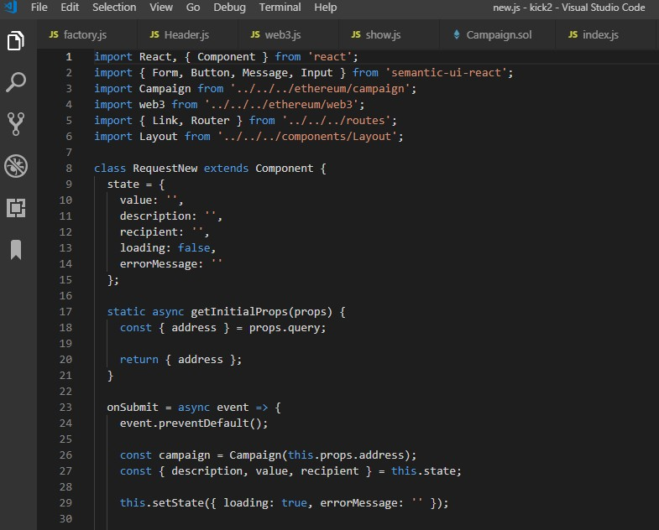
Implementation
Front end code to create a new request

Slide 25
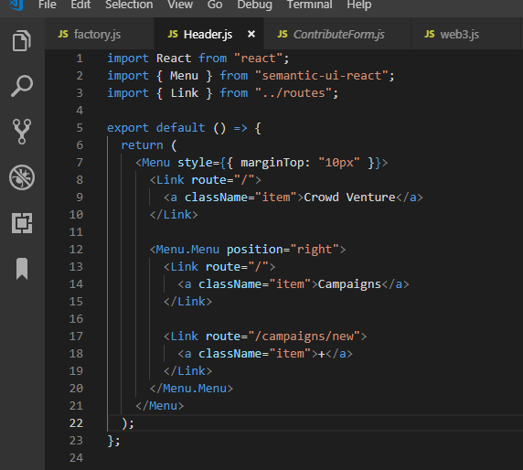
Implementation
Front end code to create a header

Slide 26
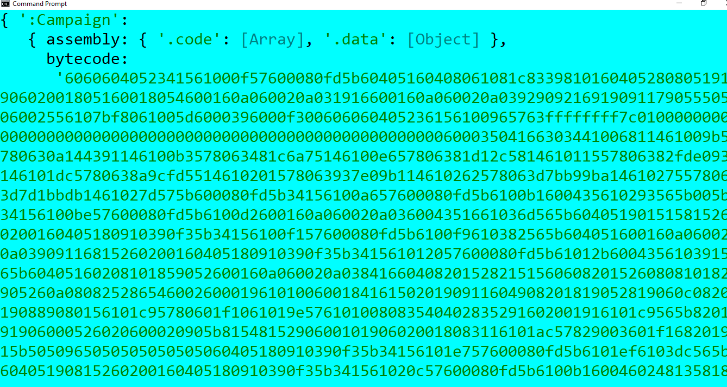
Results
Execution of compile file

Slide 27
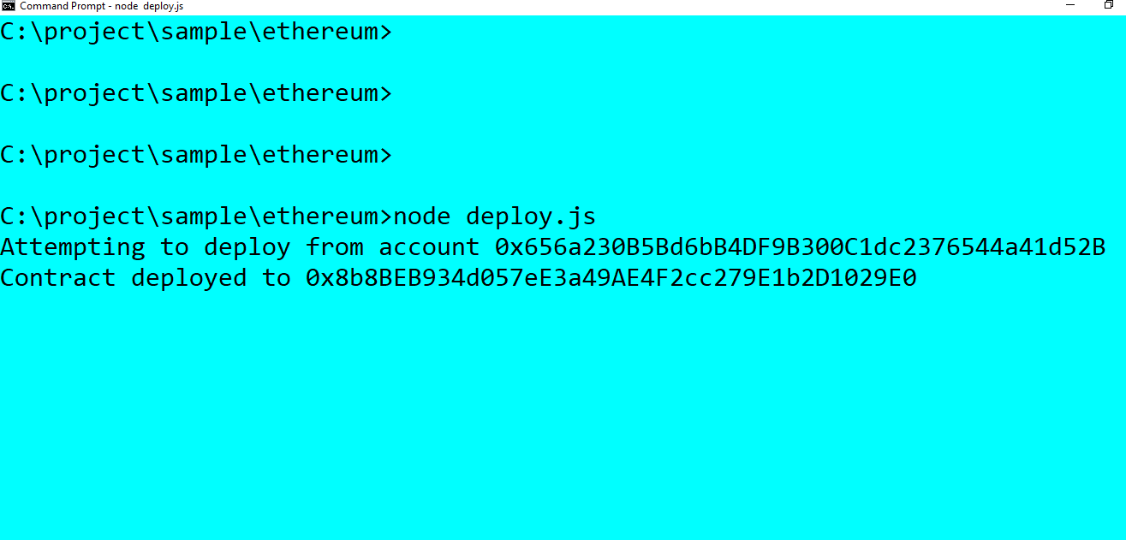
Results
Execution of deploy file

Slide 28
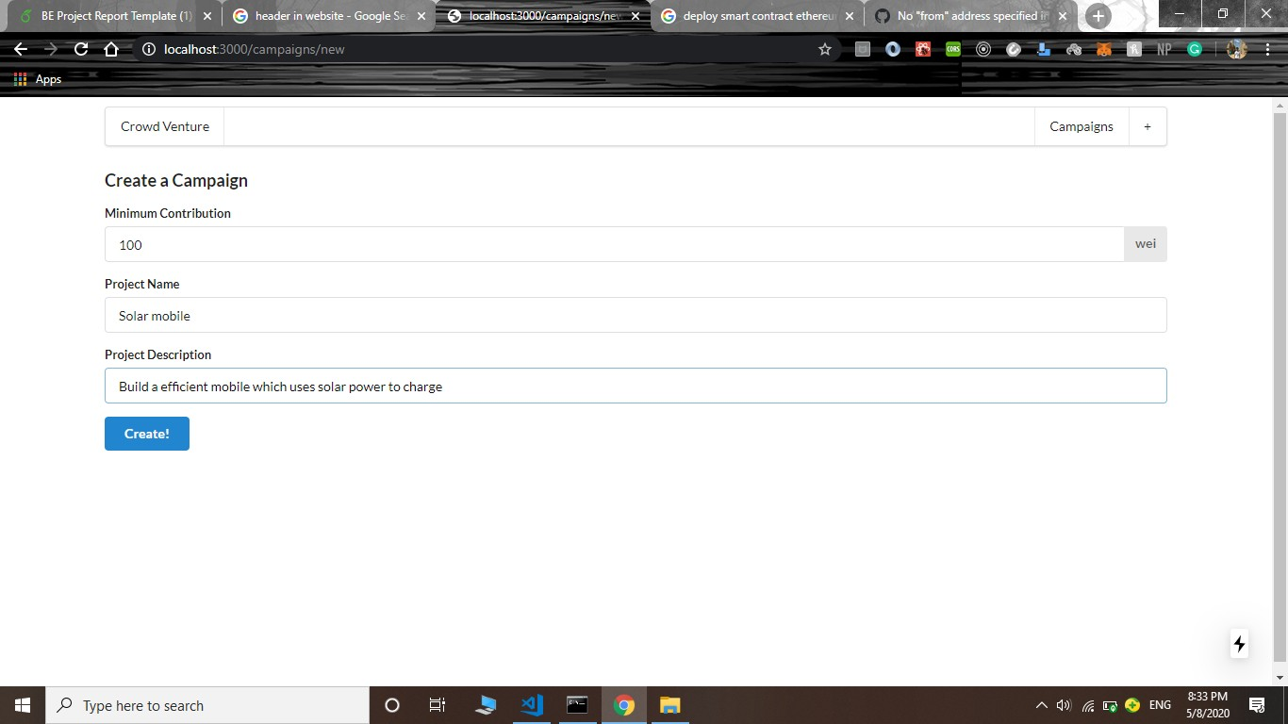
Results
Creation of new project

Slide 29
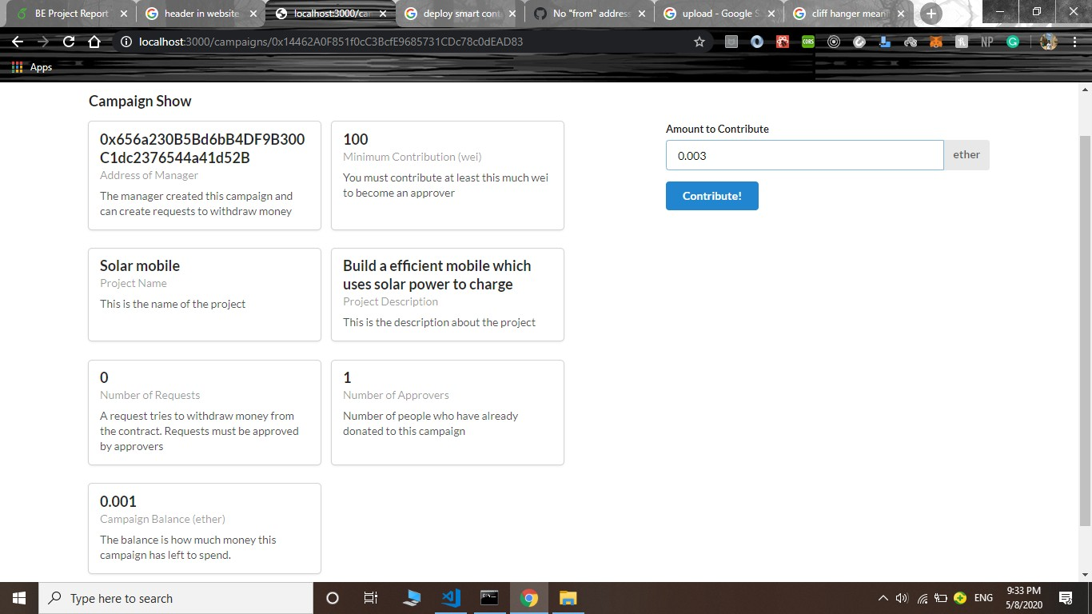
Contribute to a existing project with minimum contribution
Results

Slide 30
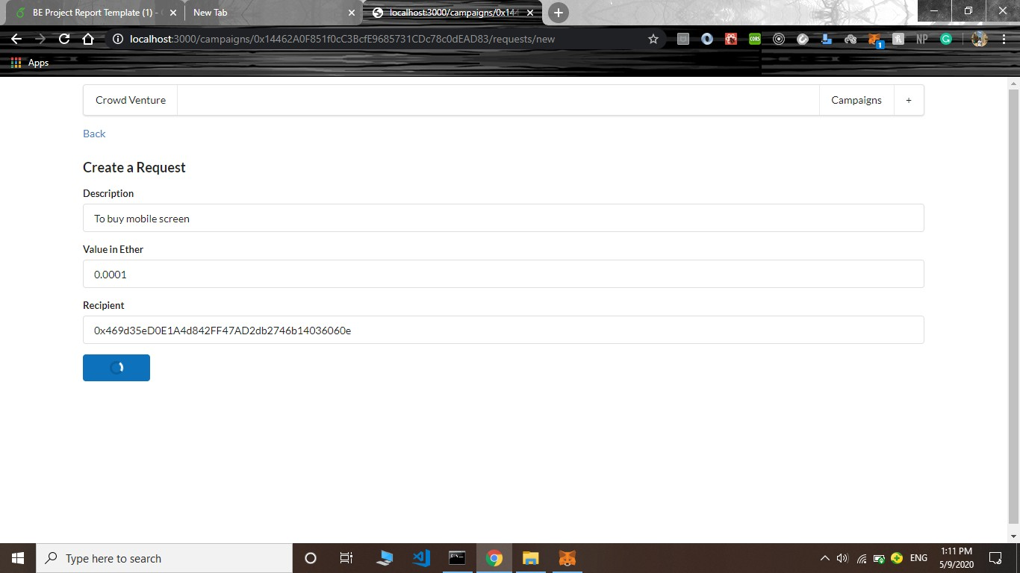
Results
Creation of new request

Slide 31
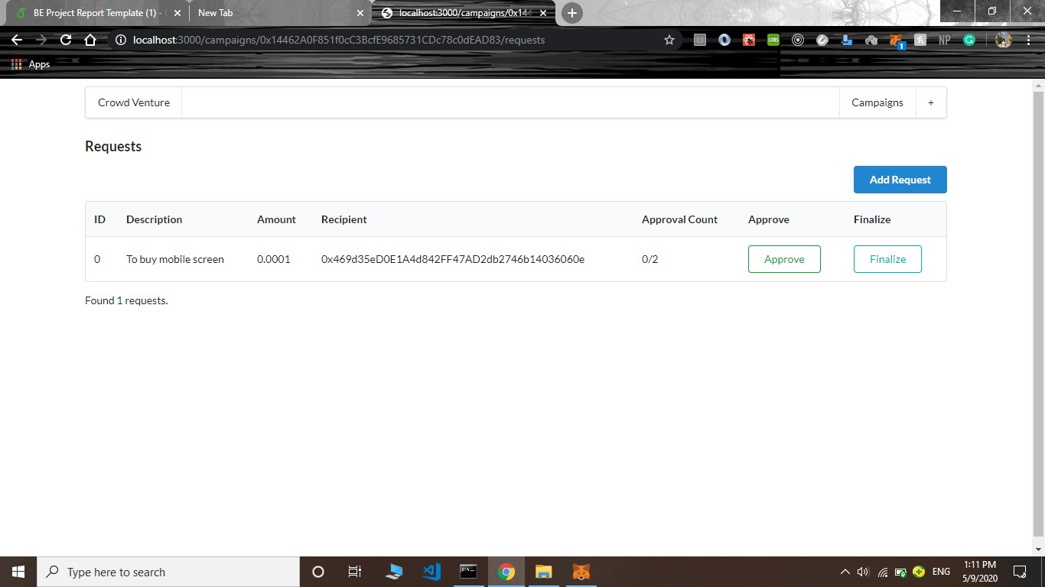
Results
List of all existing requests

Slide 32

Request turns green when more then half contributors approve
Results

Slide 33

Results
After finalization, the request is disabled

Slide 34
Conclusion and future scope
Blockchain in crowdfunding is a relatively new concept to the community.Because blockchain makes the funding process safe and offers completely transparent access from anywhere in the world, crowdfunding platforms that use blockchain can help to maximize the success of a project.
Till now, we have successfully wrote a solidity code for campaign contract and complied it using solidity compiler.The output of solidity compiler was byte code and interface which is deployed into the ethereum blockchain using metamask. After deploying the project a decentralized web app is created with frontend for creating a new project, contributing to a project, creating a new request, approving a request and finalizing a request.

Slide 35
Conclusion and future scope
At present, the blockchain application in equity management is still in the exploratory stage; there are many legal and technical issues to be resolved. There is still a need for blockchain enterprises and market managers to actively cooperate with each other,implement blockchain applications, and introduce innovative solutions. They need to deepen their understanding of blockchain technology, its value, its opportunities, and its risks.
With the evolution of Blockchain, our application has a bright future and a large scope for improvement and evolution. In the future, we wish to provide an even easier and safer way for all ideas to get life through our crowdfunding application.

Slide 36
References
Nakamoto, S. (2008)
Bitcoin: A peer-to-peer electronic cash system
Available at https://bitcoin.org/bitcoin.pdf
Buterin, V. (2014)
A next-generation smart contract and decentralized application platform
Available at https://github.com/ethereum/wiki/wiki/White-Paper.
Solidity
The Solidity Contract-Oriented Programming Language
Available at https://github.com/ethereum/solidity

Slide 37
The End

